Slide 1


JDBC
SAMAR MANSOUR

Slide 2
Concept
Structure of JDBC
Types of driver
Driver manager class

Slide 3
What is JDBC?
Java Database Connectivity (JDBC) is an API (Application Program Interface) or platform-independent interface which helps to connect java programs with various databases such as Oracle, My SQL, MS Access and SQL Server.
It provides ways to query and update the database using Structured Query Language (SQL) update statements such as CREATE, DELETE, INSERT and UPDATE and query statements like SELECT. It is almost similar to ODBC (Open Database Connectivity) that was provided by Microsoft.

Slide 4
How to connect our program/application with DB?
1. Load the Driver: Driver helps to make a connection to the database hence driver must be loaded once in the program. This can be done by two methods:
Class.forName(): By using this, the driver’s class file is loaded in the memory during run time. There is no need to create a new object. For example:
Class.forName(“oracle.jdbc.driver.OracleDriver”);
DriverManager.registerDriver(): Here DriverManager is an inbuilt Java class where the register is its static member. By using this, the constructor of the driver class is called during compile time. In this new object is created. For example:
DriverManager.registerDriver(new oracle.jdbd.driver.OracleDriver());

Slide 5
2. Creating Connections: After the driver is loaded, the connection is set up. The connection object uses username, password, and URL to set up the connection. URL has a predefined format which contains database name, the driver used, IP address where the database is stored, Port number and the service provider. The connection can be set up by using the command:
Connection con = DriverManager.getConnection(URL, user, password);

Slide 6
3. Creating Statement: After establishing the connection, the user can interact with the database. The interfaces such as JDBC statement, PreparedStatement, CallableStatement provides methods that allow a user to send SQL statements and get data from the database. Command used to create statement is;
Statement stmt = con.createStatement();

Slide 7
4. Executing Query: The SQL query is executed to interact with the database. A query can be for updating/inserting in the database or for retrieving data. Statement interface provides two methods i.e. executeQuery() method to execute queries for retrieving data while executeUpdate() method to execute queries for updating or inserting. For Example:
int n = stmt.executeUpdate(“DELETE TABLENAME”);
if(n==1)
System.out.println(“Success”);
else
System.out.println(“Failed”);

Slide 8
5. Closing Connection: After executing our query, the data user wanted to update or retrieve has been done so now it’s time to close the established connection. The connection interface provides a method close() to close the connection. For example:
con.close();

Slide 9
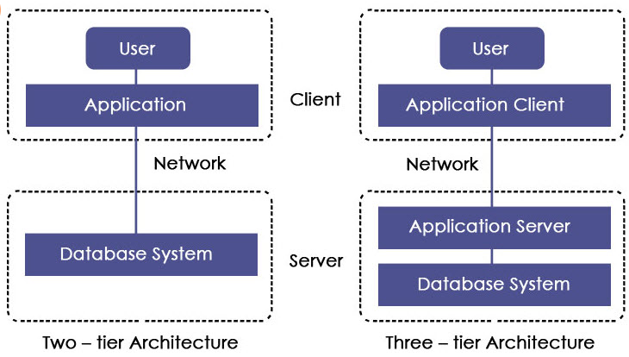
JDBC Architecture

Slide 10
Components of JDBC Architecture
Driver Manager
Driver
Connection
Statement
ResultSet
SQLException

Slide 11
Java App
JDBC API
JDBC Driver Manager
JDBC Driver
JDBC Driver
JDBC Driver
Oracle
SQL SERVER
MySQL

Slide 12
Types of JDBC drivers
Type-1 Driver or JDBC-ODBC Bridge
This driver acts as a bridge between JDBC and ODBC. It converts JDBC calls into ODBC calls and then sends the request to ODBC driver.
Type-2 Driver or Native API Partly Java Driver
This driver uses JNI (Java Native Interface) call on database specific native client API. It is comparatively faster than Type-1 driver but it requires native library and cost of application also increases.

Slide 13
Types of JDBC drivers
Type-3 Driver or Network Protocol Driver
These drivers communicate to JDBC middleware server using proprietary network protocol. This middleware translates the network protocol to database specific calls. They are database independent. They can switch from one database to another but are slow due to many network calls.
Type-4 or Thin Driver
This driver is also called pure Java driver because they directly interact with the database. It neither requires any native library nor middleware server. It has better performance than other drivers but comparatively slow due to an increase in a number of network calls.

Slide 14
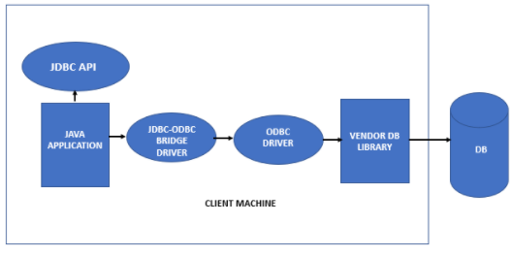
Type-1 Driver or JDBC-ODBC Bridge

Slide 15
Type-1 Driver or JDBC-ODBC Bridge Advantages and disadvantages
Advantages:
Independent of database connected
Easy to use
In-built with JDK
Connection to the database can be done easily
Disadvantages:
ODBC driver has to be installed on the machine of the client.
Not a portable driver.
Performance degradation as JDBC calls is converted to ODBC calls.

Slide 16
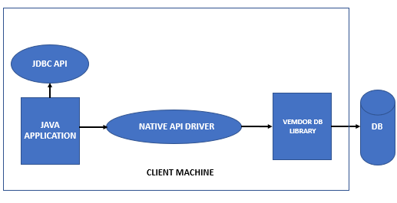
Type-2 Driver or Native API Partly Java Driver

Slide 17
Type-2 Driver or Native-API driver Advantages and disadvantages
Advantages:
Faster than JDBC-ODBC bridge driver.
Secure data transfer compared to the type-1 driver.
Upgraded performance compared to Type-1 driver.
Disadvantages:
Platform dependent
Except for applets, all java applications are supported by the driver.
Client-side libraries do not exist in all databases.
The vendor-client library, as well as vendor-specific driver, has to be installed in the machine of the client.
Not a portable driver

Slide 18
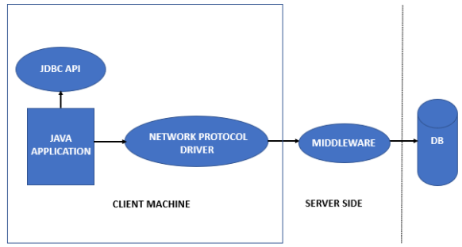
Type-3 Driver or Network Protocol Driver

Slide 19
Network protocol driver
Advantages:
The client-side library is not required as the server on the application can perform different functions such as logging, load balancing, auditing, etc.
Any DB can be handled by a single driver if the middleware is present.
Flexible
Fully written in Java
Secure
Not specific to a vendor

Slide 20
Network protocol driver
Disadvantages:
Network support is essential on the machine on the client-side.
DB specific coding is required in the middle tier.
Additional latency can occur as middleware is present.
The maintenance cost is higher.
The associated software is needed to work

Slide 21
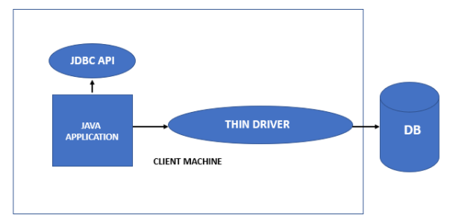
Type-4 or Thin Driver

Slide 22
Type-4 or Thin Driver Advantages
Enhanced performance compared to another type of JDBC drivers
Software need not be installed in the client as well as the server-side.
Completely written in Java
Flexible
Portable drivers
Native DB library is not required
Middleware server is not required
Also known as a native protocol driver
Platform independent
Proprietary nature
Overhead does not occur during the conversion of JDBC calls in to ODBC calls or DB API calls.
Facilitates debugging as Java Virtual Machine handles every aspect of the application to database connection.

Slide 23
Type-4 or Thin Driver Disadvantages
The driver is DB dependent

Slide 24
Which driver should be used?
If you accessing one type of database, such as Oracle, IBM or MySQL, the preferred driver type is 4.
If your java application is accessing multiple types of database at the same time, type3 is the preferred driver.
Type 2 drivers are useful in situations where a type3 or type 4 driver is not available yet for your database.
The type 1 driver is not considered a deployment-level driver and is typically used for development and testing purposes only.

Slide 25
JDBC STAMENT

Slide 26
Statment
Statement to execute static SQL statements and PreparedStatement to execute precompiled parameterized SQL statements.
On the same lines the JDBC API provides CallableStatement interface that extends PreparedStatement and used to execute SQL stored procedures.

Slide 27
JDBC Statment
A PreparedStatement is a pre-compiled SQL statement. It is a sub interface of Statement. Prepared Statement objects have some useful additional features than Statement objects. Instead of hard coding queries, PreparedStatement object provides a feature to execute a parameterized query.

Slide 28
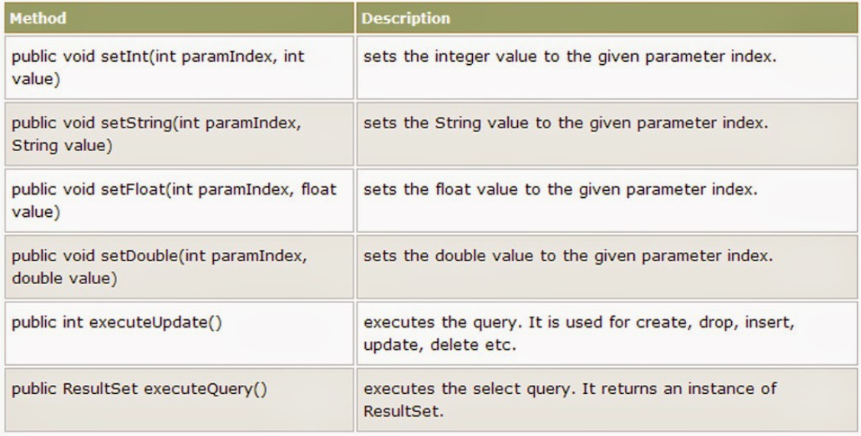
Methods of prepared Statment

Slide 29
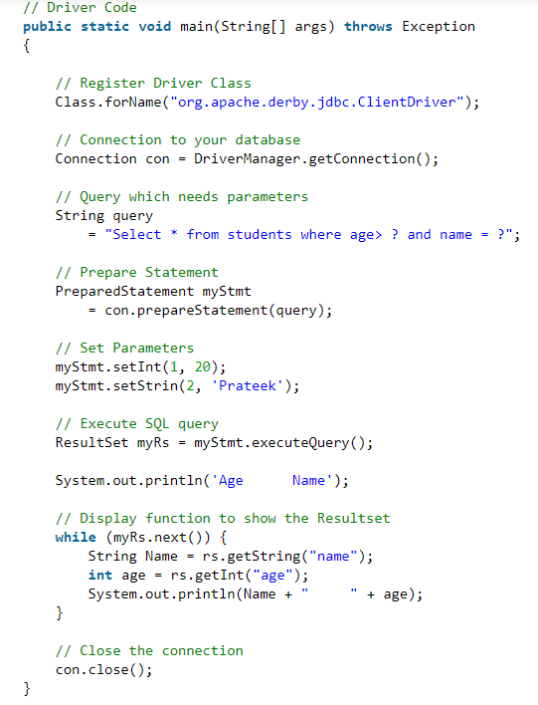
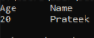
Java program to execute a query using PreparedStatement

Slide 30
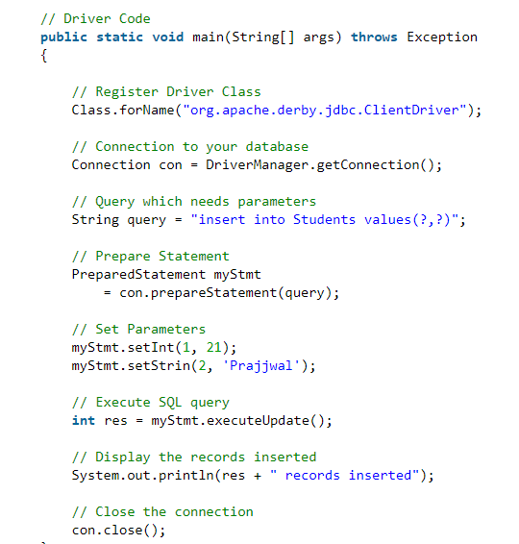
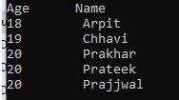
Java program to update a table using PreparedStatement

Slide 31
JDBC Statement - CallableStatement
execute the CallableStatement you can use execute() methods -
execute()- Any SQL statement. Returns a boolean which is true if the first result is a ResultSet object; false if it is an update count or there are no results.
executeUpdate()- For DML statements like Insert, Update or DDL statements like Create.
ExecuteQuery()- For SQL statement that returns ResultSet.

Slide 32
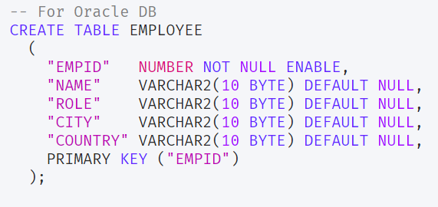
JDBC Statement - CallableStatement

Slide 33
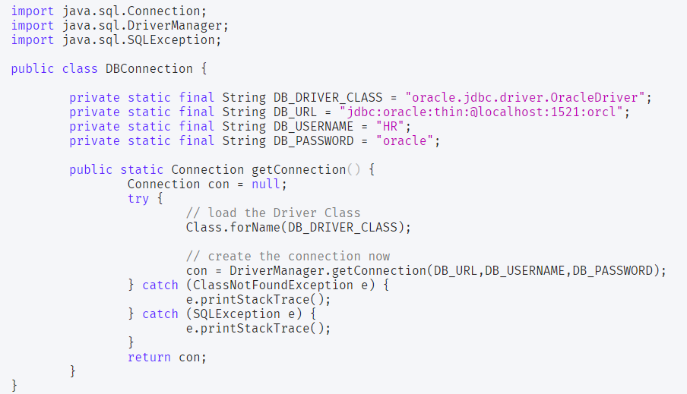
JDBC Statement - CallableStatement

Slide 34
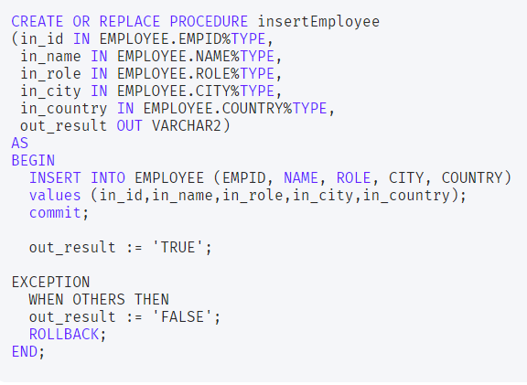
JDBC Statement - CallableStatement

Slide 35
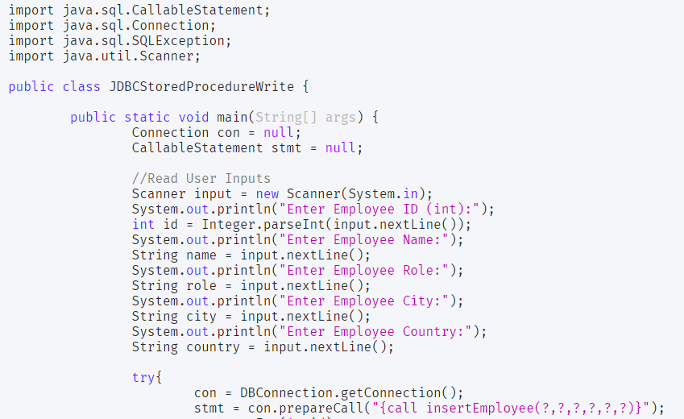
JDBC Statement - CallableStatement

Slide 36
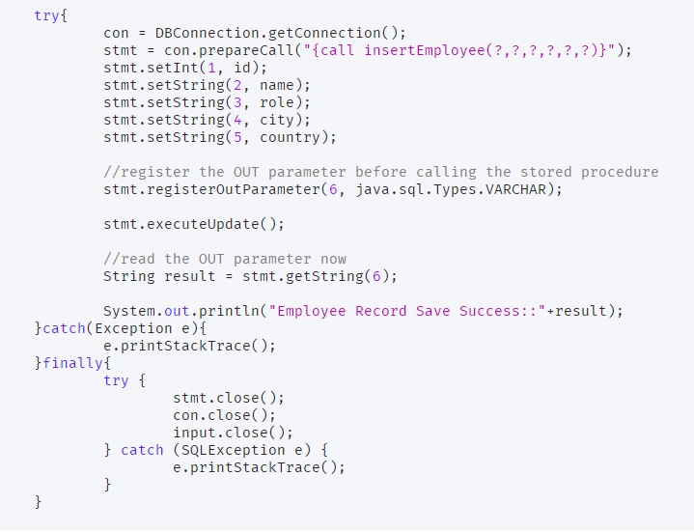
JDBC Statement - CallableStatement

Slide 37
JDBC Result set
Java ResultSet interface is a part of the java.sql package. It is one of the core components of the JDBC Framework. ResultSet Object is used to access query results retrieved from the relational databases.
ResultSet maintains cursor/pointer which points to a single row of the query results. Using navigational and getter methods provided by ResultSet, we can iterate and access database records one by one. ResultSet can also be used to update data.

Slide 38
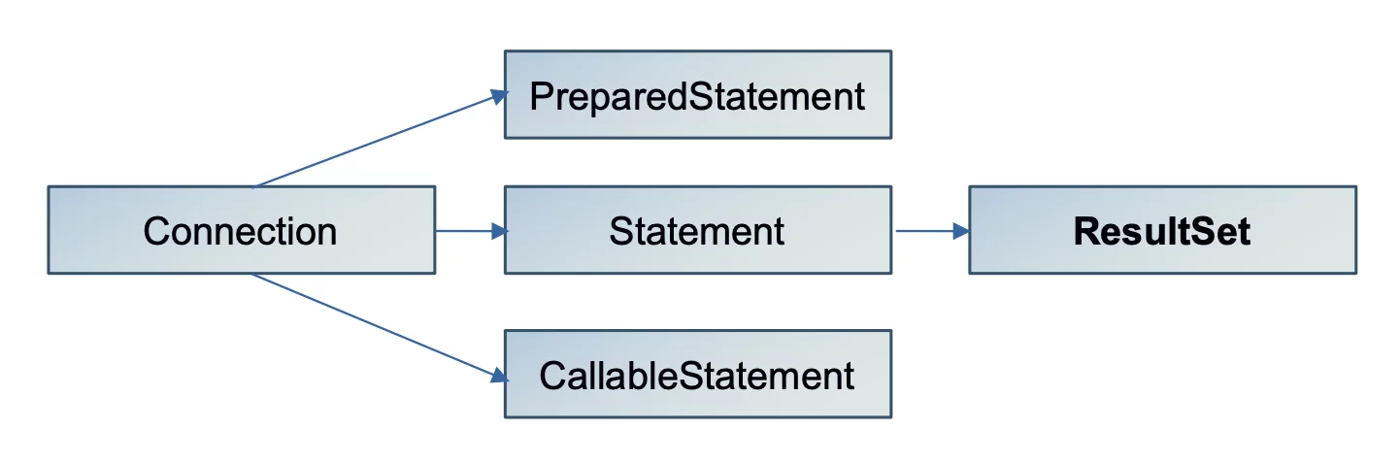
JDBC ResultSet Hierarchy

Slide 39
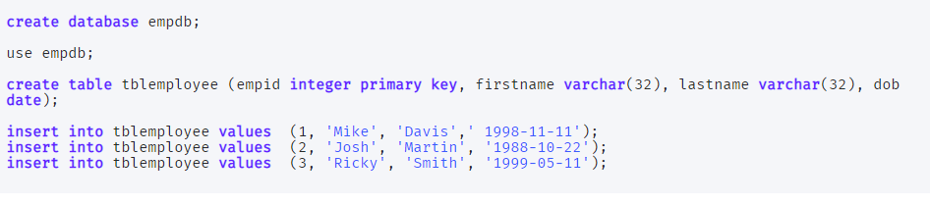
JDBC Result set

Slide 40
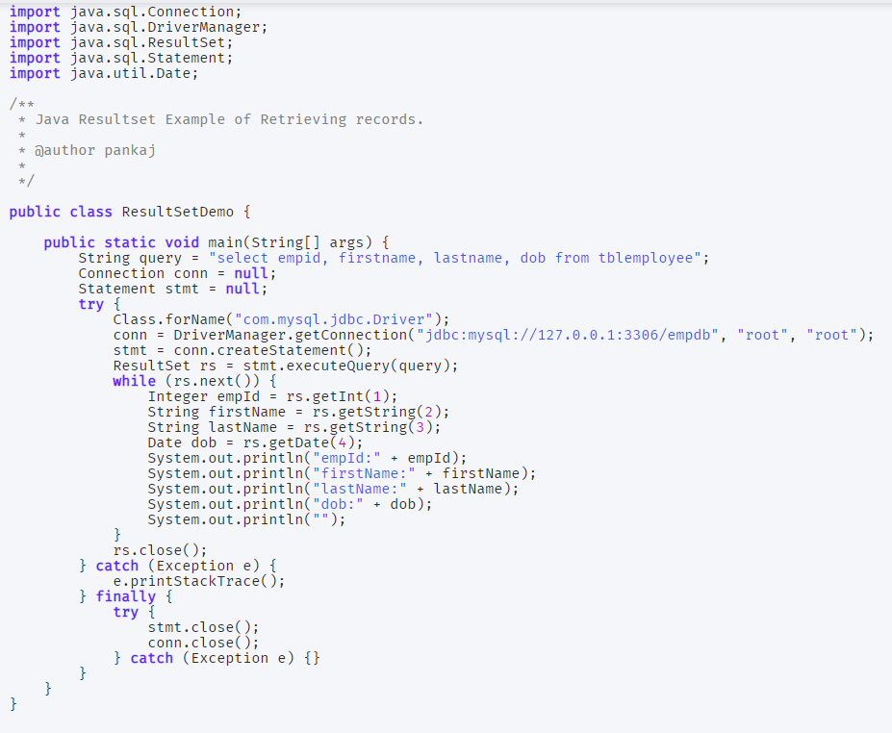
JDBC ResultSet

Slide 41
JDBC ResultSet Types
1) Forward Only (ResultSet.TYPE_FORWARD_ONLY)
This type of ResultSet instance can move only in the forward direction from the first row to the last row. ResultSet can be moved forward one row by calling the next() method. We can obtain this type of ResultSet while creating Instance of Statement, PreparedStatement or CallableStatement.

Slide 42

JDBC ResultSet Types
2) Scroll Insensitive (ResultSet.TYPE_SCROLL_INSENSITIVE)
Scroll Insensitive ResultSet can scroll in both forward and backward directions. It can also be scrolled to an absolute position by calling the absolute() method. But it is not sensitive to data changes. It will only have data when the query was executed and ResultSet was obtained. It will not reflect the changes made to data after it was obtained.

Slide 43

JDBC ResultSet Types
1) Forward Only (ResultSet.TYPE_FORWARD_ONLY)
This type of ResultSet instance can move only in the forward direction from the first row to the last row. ResultSet can be moved forward one row by calling the next() method. We can obtain this type of ResultSet while creating Instance of Statement, PreparedStatement or CallableStatement.

Slide 44
JDBC ResultSet Methods
1. ResultSet Navigational Methods
boolean absolute(int row) throws SQLException: This method moves ResultSet cursor to the specified row and returns true if the operation is successful.
void afterLast() throws SQLException: This method moves ResultSet cursor to the position after the last row.
void beforeFirst() throws SQLException: This method moves ResultSet cursor to the position before the first row.
boolean first() throws SQLException: This method moves ResultSet cursor to the first row.
boolean last() throws SQLException: This method moves ResultSet cursor to the last row.
boolean next() throws SQLException: This method moves ResultSet cursor to the next row.
boolean previous() throws SQLException: This method moves ResultSet cursor to the previous row.

Slide 45
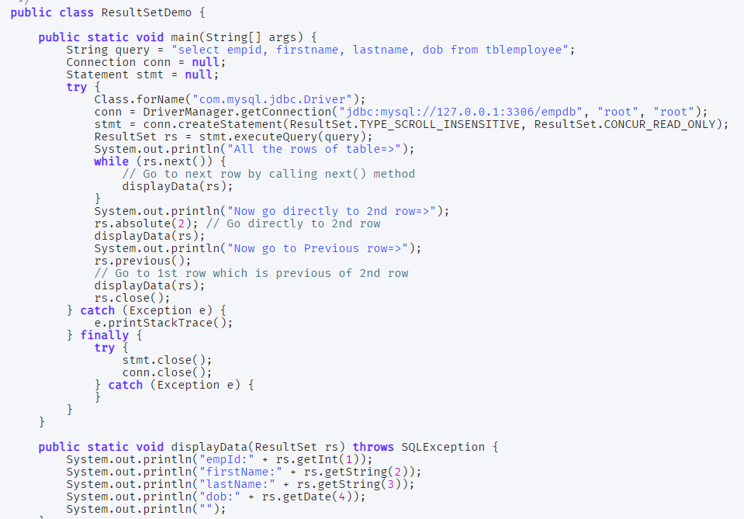

Slide 46
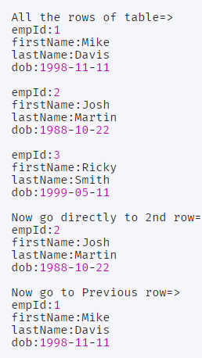

Slide 47
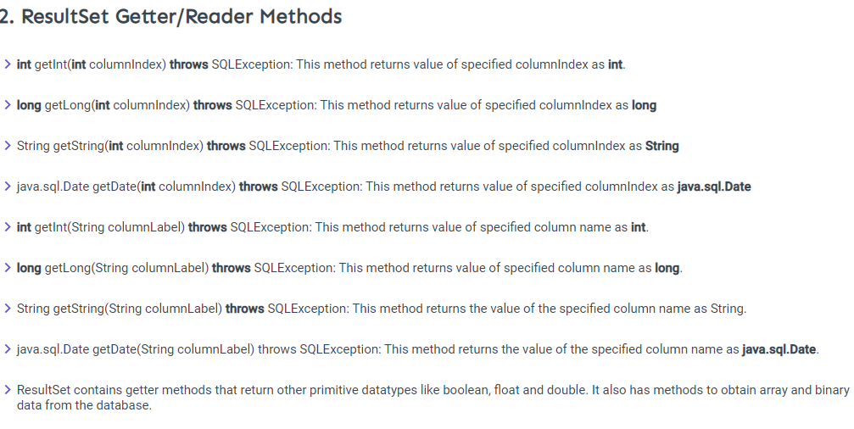

Slide 48
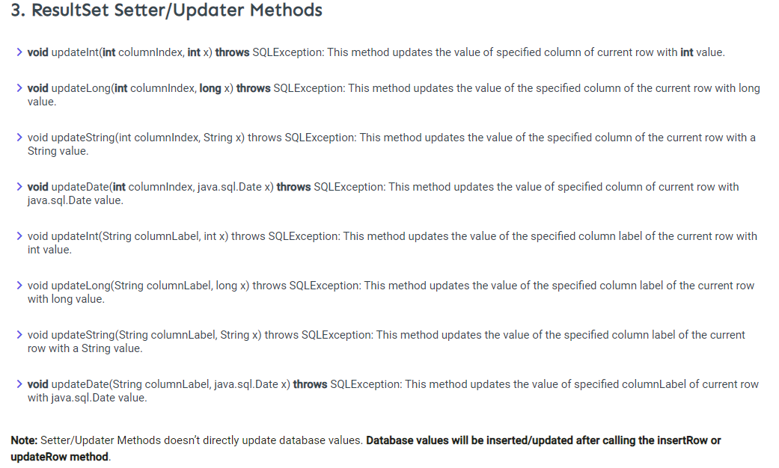

Slide 49
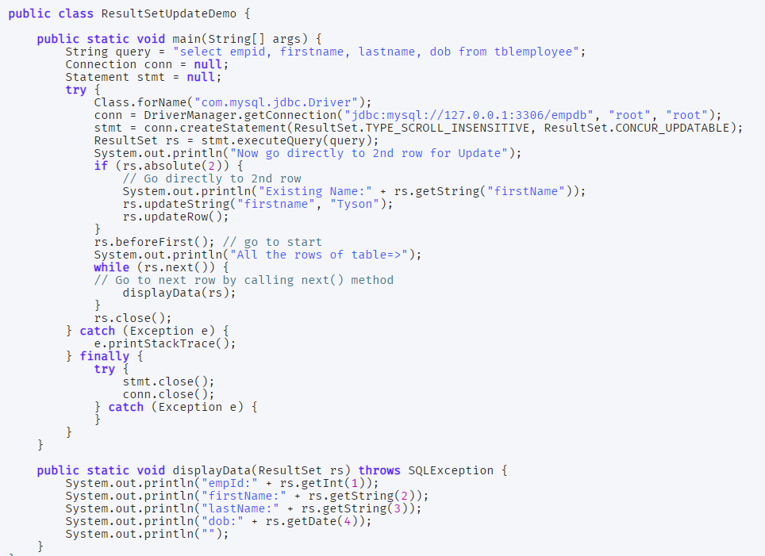

Slide 50
